Slide 1

NEW EMPLOYEE
PAYROLL ORIENTATION

Slide 2
CONTACT INFORMATION
HR PAYROLL
MONICA HOLLINGSHEAD
HR PROGRAM REPRESENTATIVE
MONICA.HOLLINGSHEAD@ARKANSAS.GOV
501-435-2457
MARK SHUFFIELD
PAYROLL SERVICES SPECIALIST
MARK.SHUFFIELD@ARKANSAS.GOV
501-435-2416
MICHELLE YOUNG-HOBBS
DOM CHIEF OF HUMAN RESOURCES
MICHELLE.YOUNGHOBBS@ARKANSAS.GOV
501-435-2480

Slide 3
Payroll Orientation Agenda
Payroll Policies
Payroll Calendar
Holiday Calendar
Special Paid Leave
EASE - Timekeeping and Payroll System
W2
Install EASE

Slide 4
Payroll Policies
www.transform.ar.gov/personnel/resources/policy/
Click on Leave, Leave Transfer, and Leave Payout for a list of policies
45 – Annual Leave
46 – Bone Marrow or Organ Donation Leave
47 – Catastrophic Leave
48 – Child Educational Activity Leave (CEAL)
49 – Educational Leave
50 – Emergency, Disaster Service Volunteer, and Emergency/Rescue Services Leave
51 – Family and Medical Leave Act (FMLA)
52 – Holidays and Birthdays
53 – Inclement Weather
54 – Leave Transfer and Leave Payout
55 – Leave Without Pay
56 – Maternity Leave
57 – Military Leave
58 – Serving as a Juror or Witness
59 – Sick Leave
60 – Workers’ Compensation

Slide 5
Bi-Weekly Pay Schedule FY24
Pay Period FY24 | Pay Period Begins | Pay Period Ends | Payroll Processing call HR before making changes | Pay Date
14 | 6/25/23 | 7/8/23 | 7/10/23 | 7/14/23
15 | 7/9/23 | 7/22/23 | 7/24/23 | 7/28/23
16 | 7/23/23 | 8/5/23 | 8/7/23 | 8/11/23
17 | 8/6/23 | 8/19/23 | 8/21/23 | 8/25/23
18 | 8/20/23 | 9/2/23 | 9/5/23 | 9/8/23
19 | 9/3/23 | 9/16/23 | 9/18/23 | 9/22/23
20 | 9/17/23 | 9/30/23 | 10/2/23 | 10/6/23
21 | 10/1/23 | 10/14/23 | 10/16/23 | 10/20/23
22 | 10/15/23 | 10/28/23 | 10/30/23 | 11/3/23
23 | 10/29/23 | 11/11/23 | 11/13/23 | 11/17/23
24 | 11/12/23 | 11/25/23 | 11/27/23 | 12/1/23
25 | 11/26/23 | 12/9/23 | 12/11/23 | 12/15/23
26 | 12/10/23 | 12/23/23 | 12/25/23 | 12/29/23
1 | 12/24/23 | 1/6/24 | 1/8/24 | 1/12/24
2 | 1/7/24 | 1/20/24 | 1/22/24 | 1/26/24
3 | 1/21/24 | 2/3/24 | 2/5/24 | 2/9/24
4 | 2/4/24 | 2/17/24 | 2/19/24 | 2/23/24
5 | 2/18/24 | 3/2/24 | 3/4/24 | 3/8/24
6 | 3/3/24 | 3/16/24 | 3/18/24 | 3/22/24
7 | 3/17/24 | 3/30/24 | 4/1/24 | 4/5/24
8 | 3/31/24 | 4/13/24 | 4/15/24 | 4/19/24
9 | 4/14/24 | 4/27/24 | 4/29/24 | 5/3/24
10 | 4/28/24 | 5/11/24 | 5/13/24 | 5/17/24
11 | 5/12/24 | 5/25/24 | 5/27/24 | 5/31/24
12 | 5/26/24 | 6/8/24 | 6/10/24 | 6/14/24
13 | 6/9/24 | 6/22/24 | 6/24/24 | 6/28/24

Slide 6
2023
State Holidays
Legal holidays by authority of Act 304 of 2001 and Amended by Act 561 of 2017.
January 1 . . . . . . . . . . . . . . . . . . . . . . . . . . . . . . . . . . New Year’s Day
(Observed on Monday, January 2, 2023)
January 16 . . . . . . . . . . . . . . . . . Dr. Martin Luther King Jr.’s Birthday
February 20 . . . . . . . . . . . . . . . . . . . . George Washington’s Birthday
and Daisy Gatson Bates Day
May 29 . . . . . . . . . . . . . . . . . . . . . . . . . . . . . . . . . . . . .Memorial Day
July 4 . . . . . . . . . . . . . . . . . . . . . . . . . . . . . . . . . . Independence Day
September 4 . . . . . . . . . . . . . . . . . . . . . . . . . . . . . . . . . . . . Labor Day
November 11 . . . . . . . . . . . . . . . . . . . . . . . . . . . . . . . . . Veterans Day
(Observed on Friday, November 10)
November 23 . . . . . . . . . . . . . . . . . . . . . . . . . . . . . Thanksgiving Day
December 24 . . . . . . . . . . . . . . . . . . . . . . . . . . . . . . . . Christmas Eve
(Observed on Monday, December 25)
December 25 . . . . . . . . . . . . . . . . . . . . . . . . . . . . . . . . Christmas Day
(Observed on Tuesday, December 26)

Slide 7
Special Paid Leave
The State of Arkansas offers several programs as listed under Payroll Policies. Military Leave and Military Disability Leave
Military leave may only be used by active members of the US Armed Forces which include: United States Marine Corps, United States Army, United States Navy, United States Air Force, Arkansas National Guard, and all reserve branches of the armed forces.
HR Department will need a copy of the employee’s orders. A leave balance will be created for 120 hours to be used for regular active duty, Annual training, drills, etc.…

Slide 8
Special Paid Leave cont.
Military Leave Disability The employee shall be entitled to his or her regular salary during the time the employee is away from his or her duties during the leave of absence. The leave with pay may not exceed 6 days for the purpose specified in this law during any one calendar year. The leave of absence shall be in addition to the regular annual leave and sick leave allowed to the employee.

Slide 9
EASE (Empowering Arkansas State Employees)
The Department of Military operates its Payroll through the State of Arkansas EASE Automated Timekeeping and Attendance System. This system helps streamline our Payroll Processes.
YOU ARE RESPONSIBLE FOR ENTERING YOUR TIME AND LEAVE!
IF YOU DO NOT ENTER YOUR TIME OR LEAVE, YOU WILL NOT BE PAID!

Slide 10
Timesheets (1ST time user)
Your username (or “communication ID”) will be given to you by your Human Resources Analyst.
To obtain your password, call the AASIS helpline at 1-501-683-2255.
You will need to have your username, personnel number, and social security number ready, as you will be asked for this information to obtain your temporary 1st time password for EASE.
Once you have obtained your temporary password, you can log into EASE and you will be prompted to change the password.

Slide 11
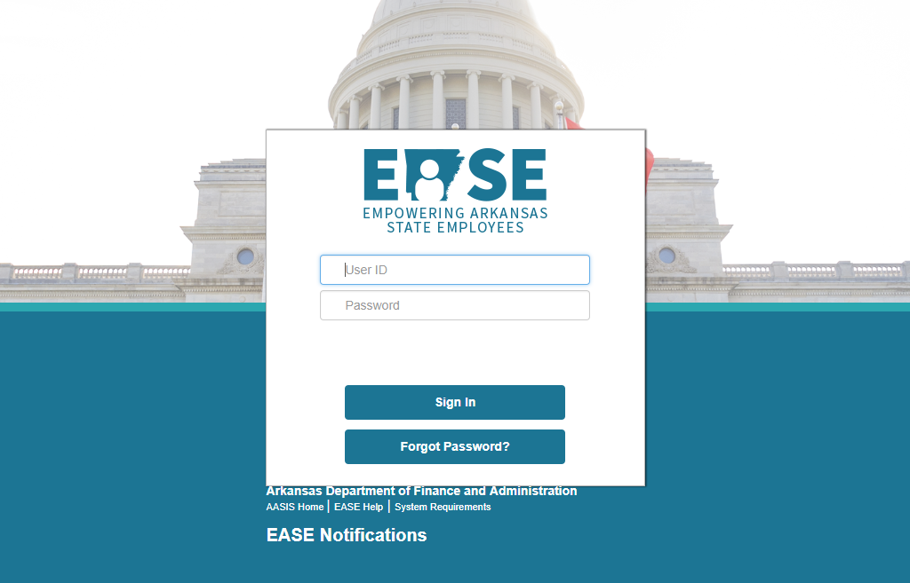
Timesheet entry
if you do not enter your time and/or leave you will not be paid.
Access EASE by typing in “EASE Arkansas” in the search bar
Enter your username and password
Click “Sign In”
11

Slide 12
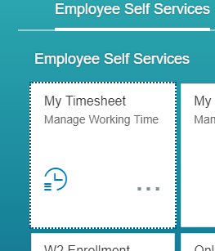
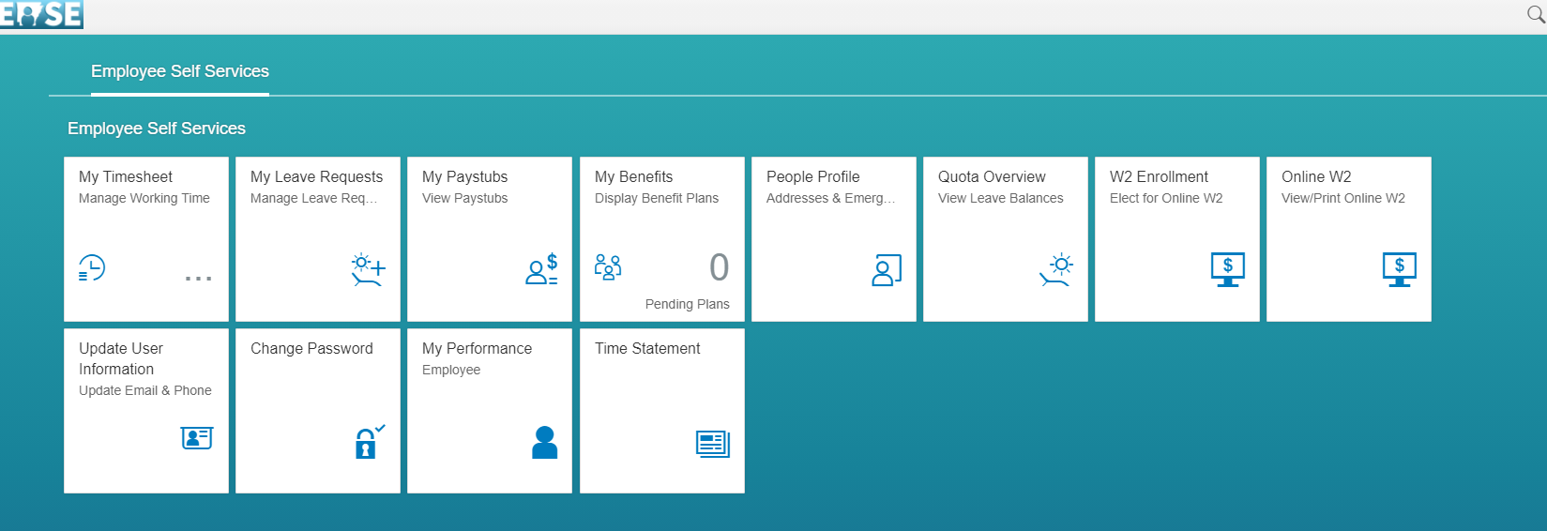
Timesheet entry
Home screen
Select “My Timesheet”

Slide 13
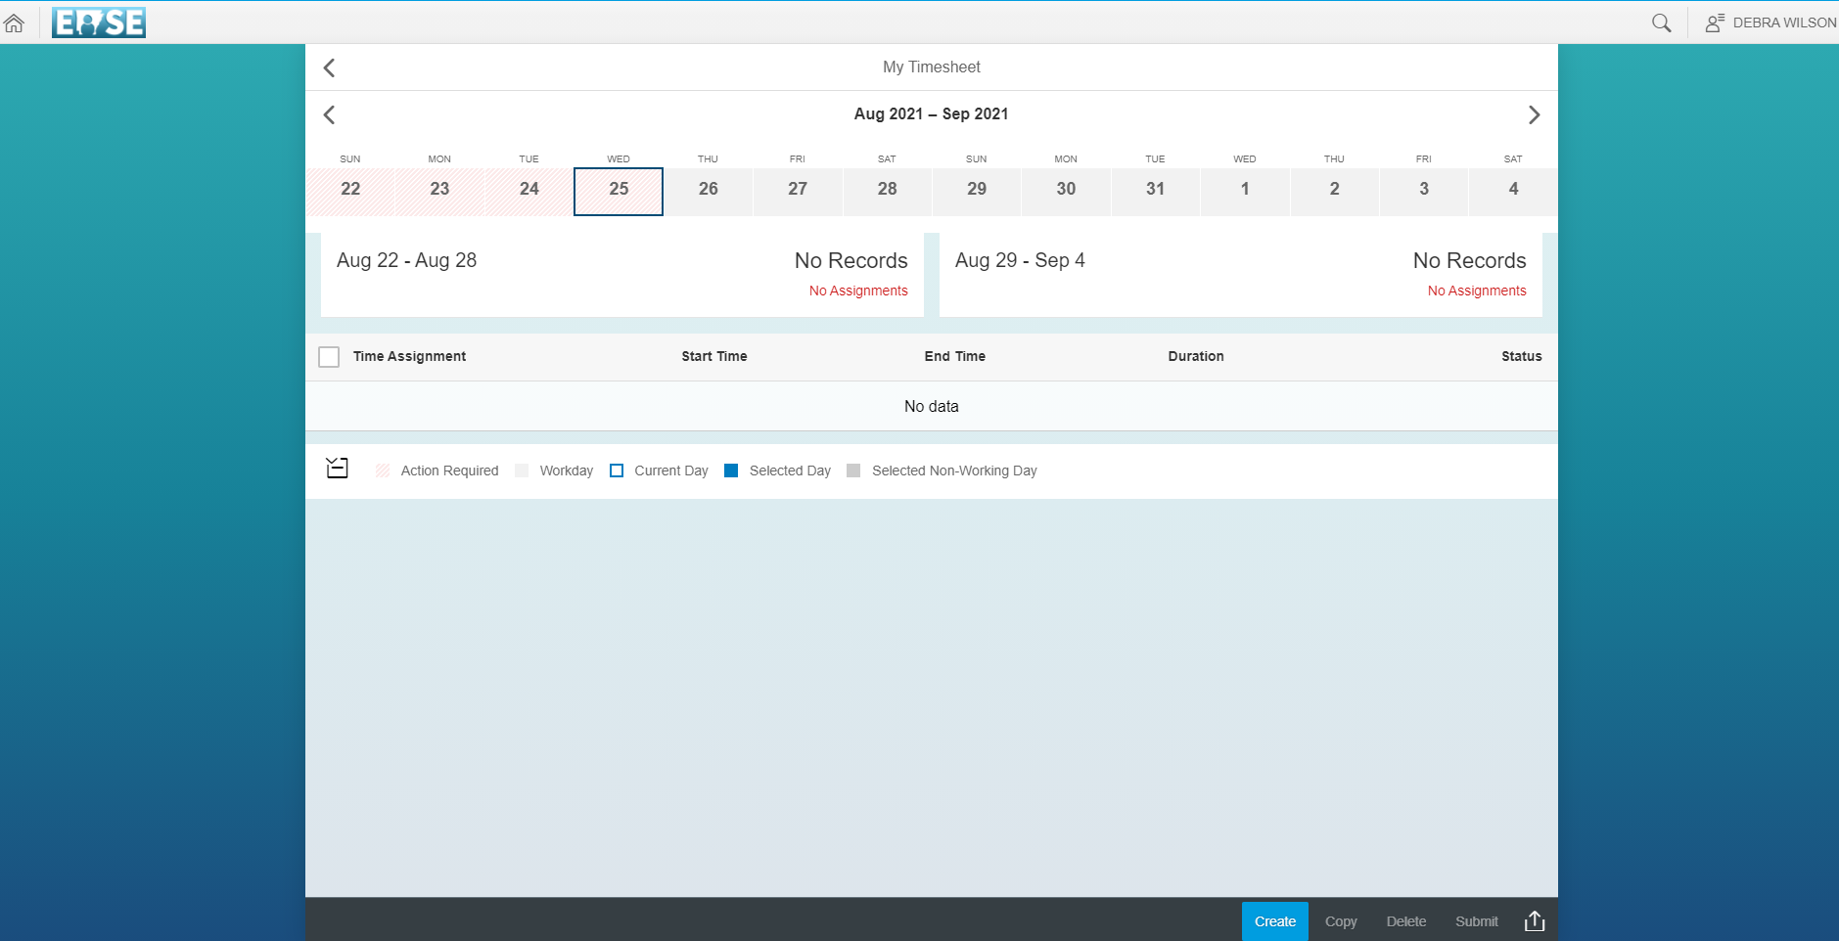
Timesheet
Entry
Select week/s for time entry.

Slide 14
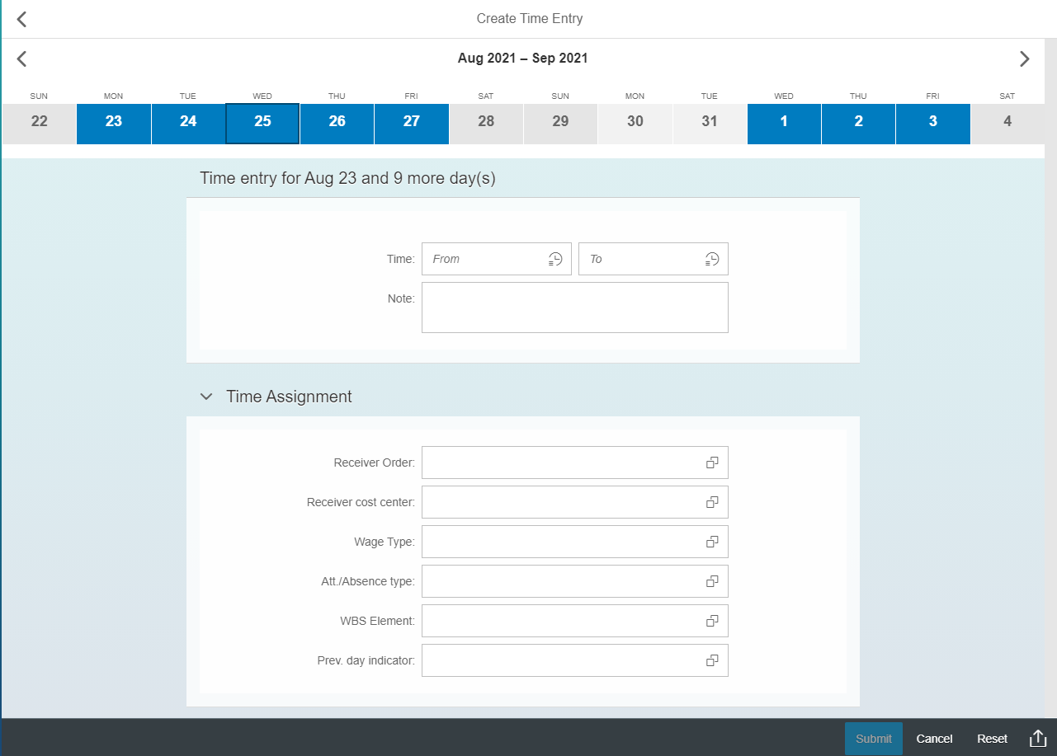
Click The dates you want to enter the same time per day.

Slide 15
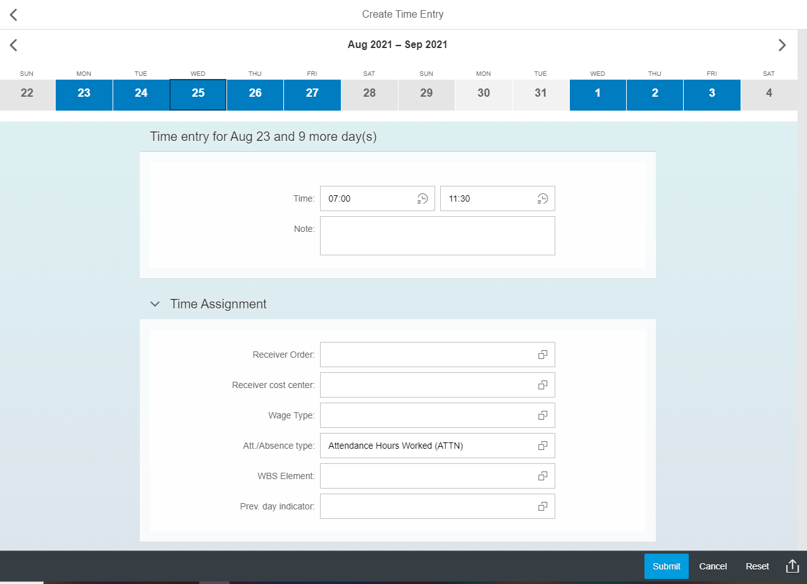
Enter arrival and leave time at lunch.
You will do another entry from lunch to end of shift.

Slide 16
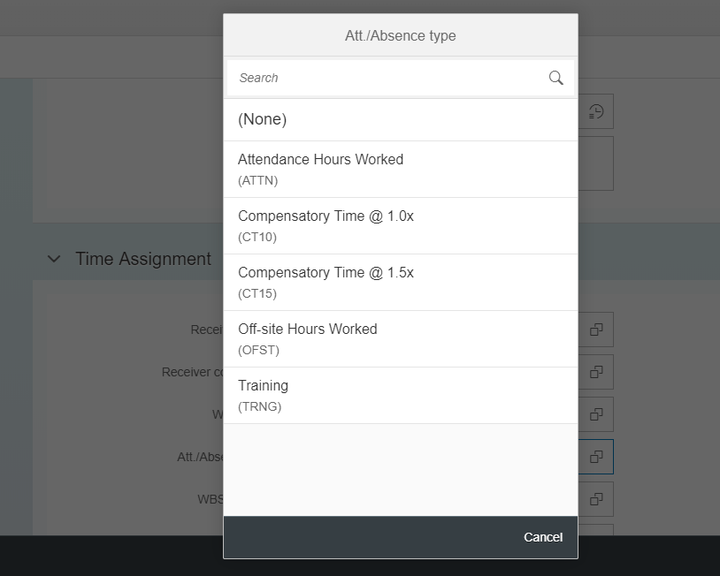
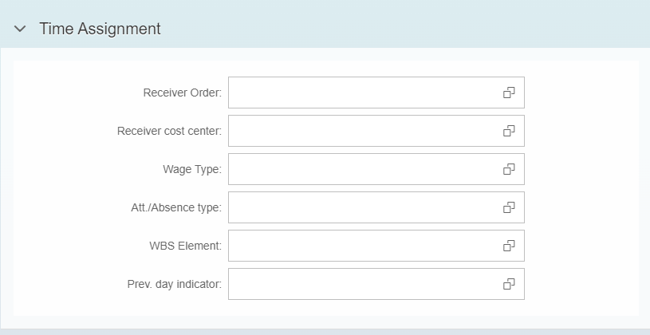
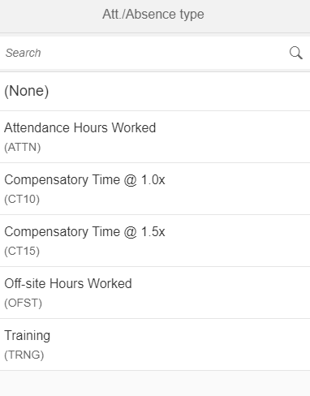
Timesheet entry
*Select “Att./Absence Type”
*Select “Attendance Hours Worked”
*Select “Submit”

Slide 17
Night/overnight shifts
If your shift requires you to start at midnight, you MUST enter your time starting at “23:59”. If you do not “break the midnight plane”, you WILL NOT receive the correct shift differential. You can still run your time straight through, but the shift MUST reflect it was started prior to 00:00.

Slide 18
It does not matter if you work days or nights.
RUN YOUR TIME THROUGH FROM BEGINNING TO THE END. YOU DO NOT NEED TO SEPARATE YOUR TIMESHEET INTO DIFFERENT DAYS.
IF YOU WORK NIGHTS, YOUR TIME SHOULD REFLECT “23:00-07:00” TO BREAK THE MIDNIGHT PLANE.
YOU CAN STILL RUN YOUR TIME THROUGH TO SUNDAY MORNING. AS LONG AS YOU BEGIN YOUR SATURDAY AT 23:59, THE TIME SHOULD ATTACH ITSELF TO SATURDAY.

Slide 19
TIMESHEETS ARE DUE EACH WEDNESDAY!
HR PAYROLL OR YOUR SUPERVISOR WILL CONTACT YOU TO ADVISE YOU OF THE CHANGES THAT NEED TO BE MADE.
ON THE MONDAY BEFORE PAYDAY, LOOK AT YOUR PAY STUB, IT IS UNDER “My Paystubs” TILE FROM THE HOME PAGE. IF IT DOESN’T LOOK CORRECT, CALL YOUR HR PAYROLL CONTACT.

Slide 20
LEAVE ENTRY

Slide 21
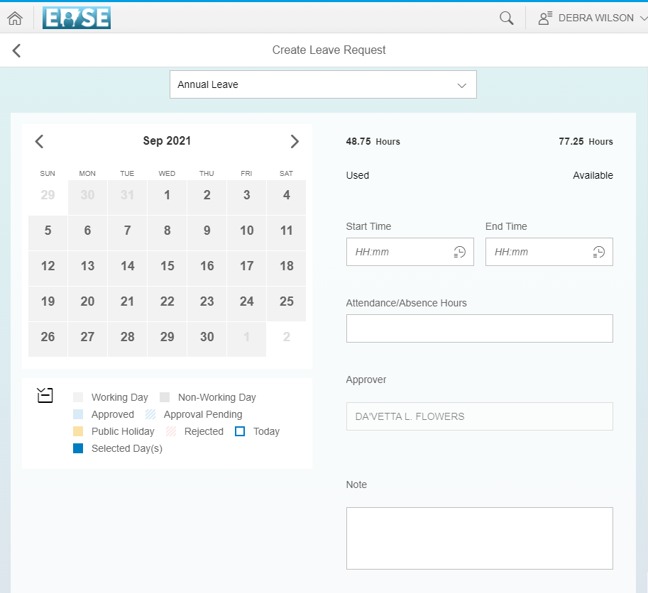
LEAVE ENTRY
* Select “My Leave Requests”
*The “Available time” for each type of leave is reflected on the right-hand side of the screen.

Slide 22
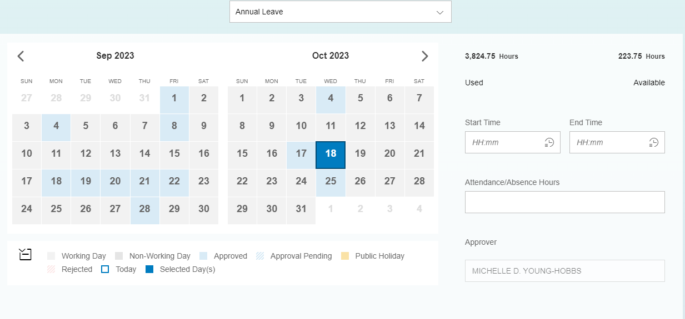
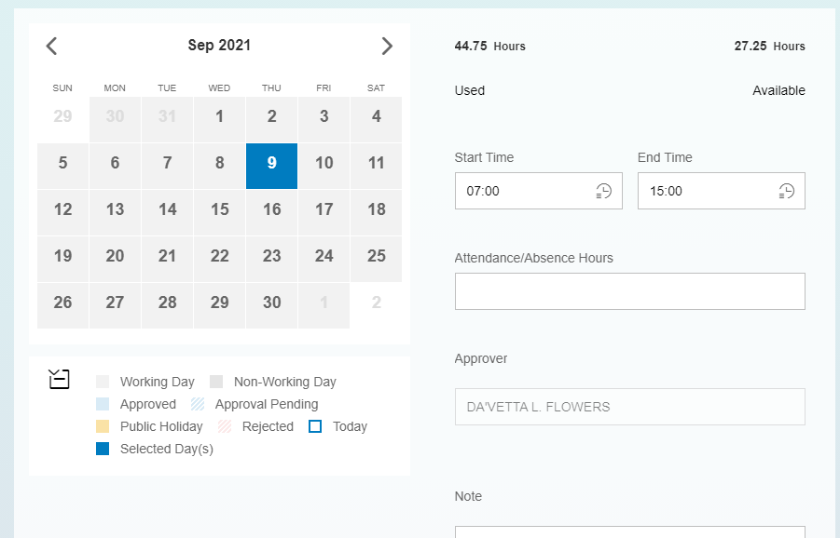
Leave entry
Select the type of leave.
Select the day you want to request leave.
Enter the time you want to take leave.
If you work nights you will need to separate your leave into separate days.
.

Slide 23
JUST A FEW NOTES…
TIMESHEETS ARE DUE EVERY WEDNESDAY!
IT IS YOUR RESPONSIBILITY TO ENTER YOUR TIME AND LEAVE.
ALWAYS CHECK YOUR PAYSTUB ON THE MONDAY OF THE WEEK YOU GET PAID. IF THERE ARE ANY DISCREPANCIES, CONTACT HR PAYROLL ASAP. THE ISSUE MIGHT BE ABLE TO BE FIXED IN THE CORRECT PAY PERIOD.
YOU CANNOT START A SHIFT AT MIDNIGHT (00:00)!
IF YOU WORK NIGHTS, YOU MUST SEPARATE YOUR LEAVE INTO 2 DAYS! USE THE “PREVIOUS DAY INDICATOR” ON THE SECOND HALF OF YOUR LEAVE REQUEST!
CONTACT HR PAYROLL BEFORE YOU MAKE AMENDMENTS!

Slide 24
NOTES CONTINUED…
*
ALWAYS MAKE SURE YOUR TIME REFLECTS THE CORRECT AMOUNT OF WORKED/LEAVE TIME PER PAY PERIOD. APPROVED LEAVE WILL NOT BE REFLECTED ON YOUR TIMESHEET. YOU MUST ADD APPROVED LEAVE TIME TO THE TOTAL TIME REFLECTED ON YOUR TIMESHEET.
DO NOT WORK AHEAD ON YOUR TIMESHEETS. THIS WILL CAUSE YOU TO LOSE TRACK OF WHAT WEEK/S YOU SHOULD BE SUBMITTING AND CAN CAUSE YOU TO DO UNNECESSARY AMENDMENTS.
YOU CANNOT REQUEST LEAVE TOO FAR IN ADVANCE, LEAVE TIME IS NOT ADDED TO YOUR ACCUMULATED LEAVE IN ADVANCE (EX. HOLIDAY LEAVE WILL NOT BE ADDED TO YOUR ACCUMULATED HOLIDAY TOTAL UNTIL THE DAY OF THE HOLIDAY).

Slide 25
If you want to receive your W-2 online, go to the home screen and click on tile named W2 Enrollment, Elect for Online W2. Follow the prompts to elect online.

Slide 26

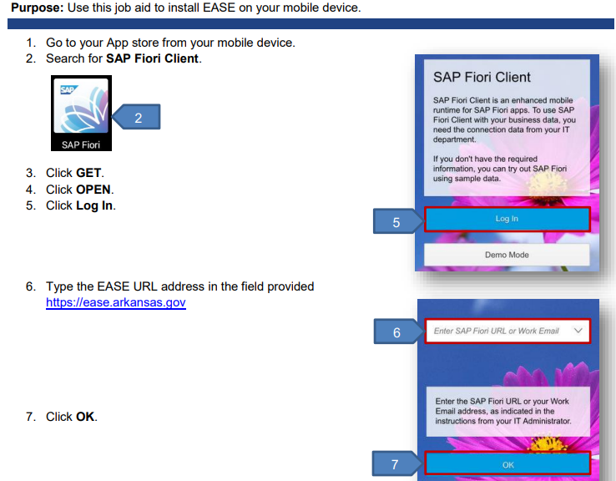

Slide 27
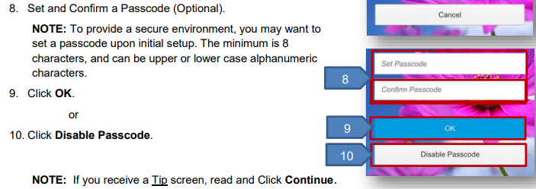

Slide 28
